Slide 1
Attendance Manager App
Murad Ali Khan
COMSC-F20-017
207719
Supervised-by
Mr.syed zulqarnain shah

Slide 2
APP INTRODUCTION
Welcome To Our Attendance Manager App
Design To :
Easy attendance tracking for teachers.
Say goodbye to paper attendance.
Keep records safe and sound.
Say goodbye to traditional methods.

Slide 3
Problem Statement
Teachers face the challenge of manually taking attendance, which is time-consuming and prone to errors, especially when calculating percentages manually.
Additionally, paper-based systems are outdated, inefficient, and risk losing or misplacing records.
Therefore, need for a digital solution that streamlines attendance tracking, automates percentage calculations, and ensures the security and accessibility of attendance records.

Slide 4
Existing System
Manual Paper-Based Systems:
Time-consuming,
Prone to errors,
Limited accessibility,
High security risks,
Storage challenges.
Barcode Scanners:
Time-consuming for processing multiple IDs and can be
expensive to implement.
Biometrics:
More secure than barcodes (fingerprint, facial recognition), technical
limitations (scanners can be expensive and require specific
conditions).

Slide 5
Technologies Used
Flutter for web and app development:
Flutter(UI).
Dart.
Firebase for backend services:
Fire-Store(Database).
Authentication.
State-Management:
Provider
Various plugins for enhanced functionality.

Slide 6
Attendance Manager App Module
Two Modules:
1- Teacher.
Mobile App.
2- Admin.
Web App.

Slide 7
Teacher Module
TEACHER MODULE

Slide 8
Teacher Module Features
Sign Up:
Create a new account.
Login:
Access your existing account.
Create/Register Subject:
Add a new subject to your account.
Add Students to Subjects:
Enroll students in the desired subjects.

Slide 9
Teacher Module Features
Take Attendance:
Mark students present or absent for specific
dates and times.
Export Attendance to Excel Sheet:
Download attendance data as a spreadsheet.
Manage Profiles,
Subjects ,
Students,
Attendance.
View Specific Student Details:
Access detailed information about a particular student
within a specific subject.

Slide 10
Admin Module
Admin Module

Slide 11
Admin Module Features
Dynamic Dashboard:
visual representation
Class Management:
Create, edit, and manage classes, assigning students and teachers.
Teacher Management:
Approve, manage, and view teacher information and access.
Student Management:
Manage, and view student information.
Attendance Management:
View and manage attendance data for all students across all subjects.
View Reports:
1=Teachers 2=subject 3=attendance 4=student

Slide 12
View Reports
Teachers:
Admin can view which subjects are assigned to each teacher.
Shows the classes taken by each teacher.
Includes the percentage of class attendance managed by each teach
Subject:
Display the attendance performance of all students in each subjects.
Shows the number of presents, leaves, and absences for students.
Includes the overall attendance percentage for each subject.

Slide 13
View Reports
Attendance:
Contains a table with all attendance records of students.
Shows the attendance percentage for each student.
Student:
Lists how many subjects a student is enrolled in.
Displays the attendance percentage for each subject the student is enrolled in.

Slide 14
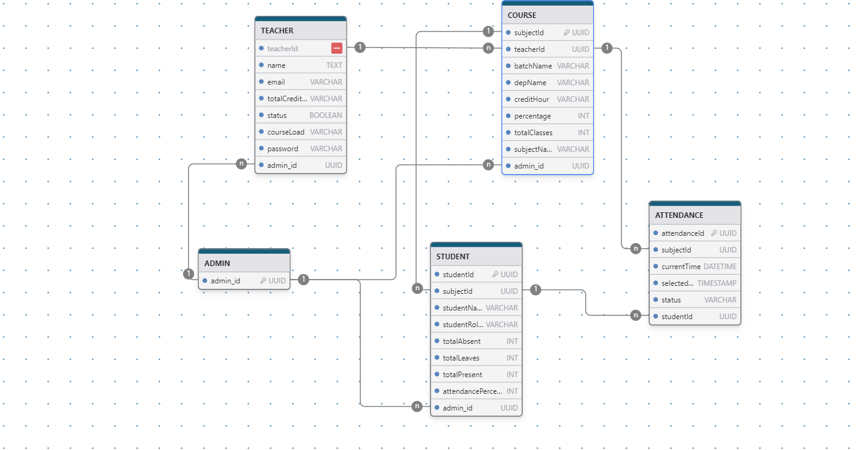
Entity Relation Diagram

Slide 15
Screens Out Put
Screens Out Put

Slide 16
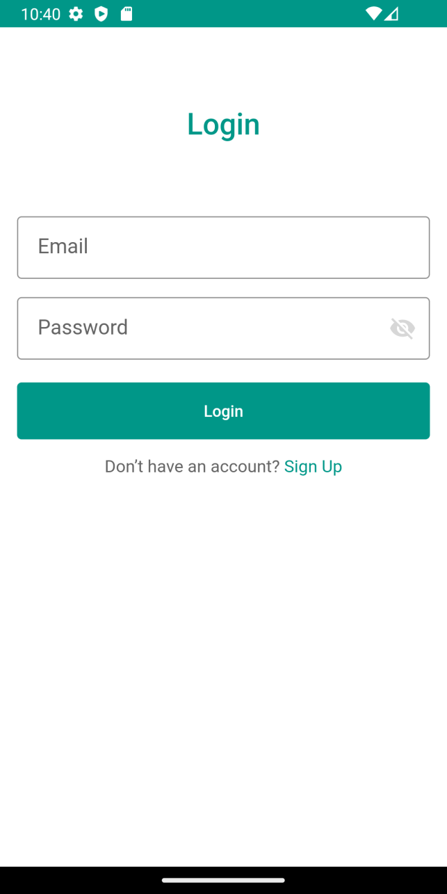
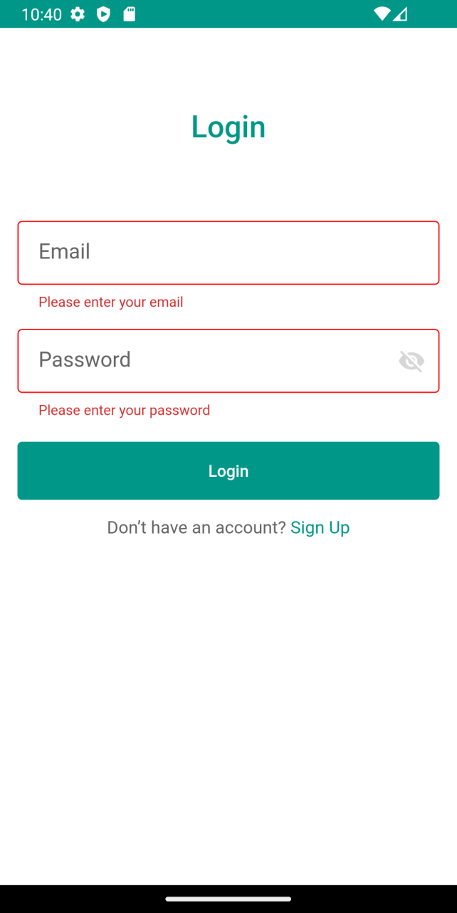
Login Section

Slide 17
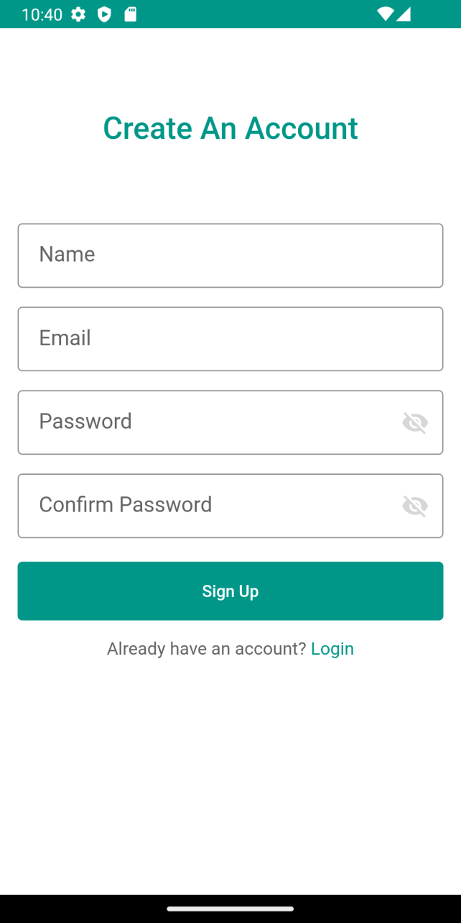
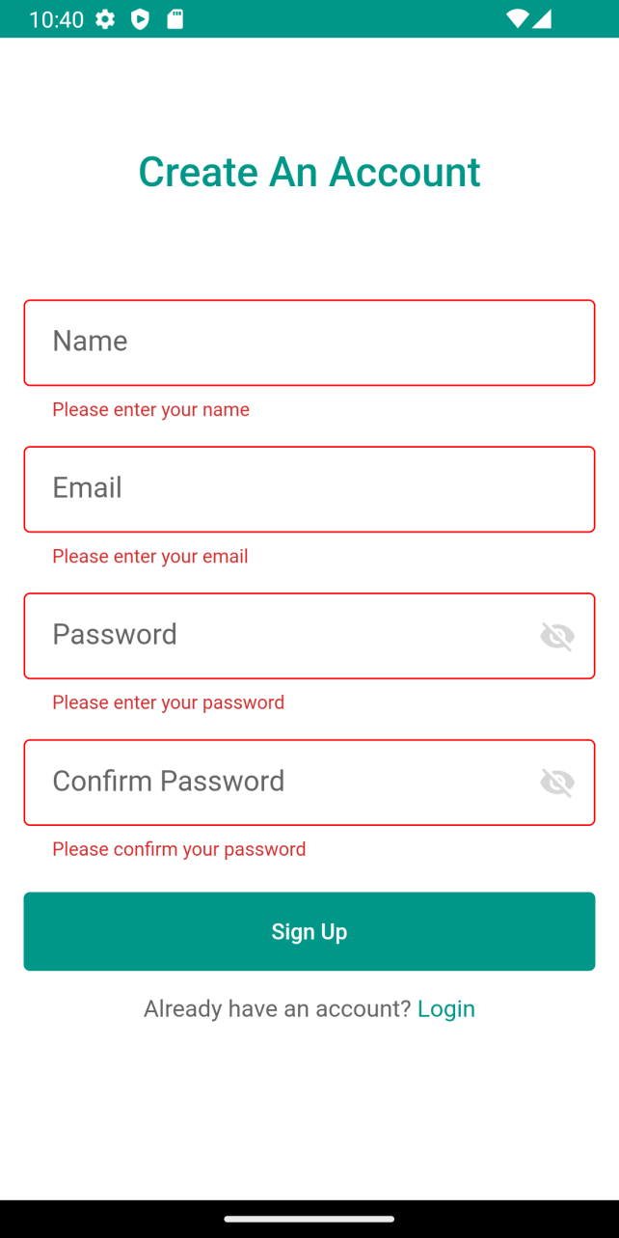
Create An Account Section

Slide 18
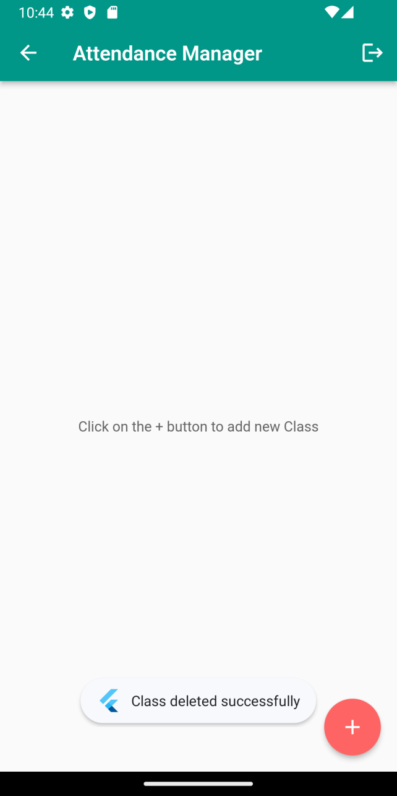
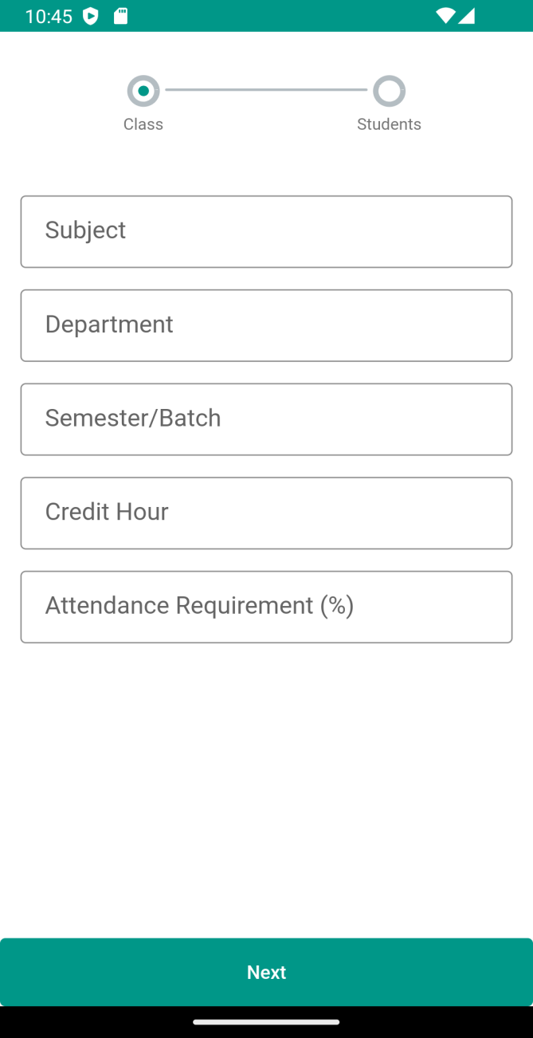
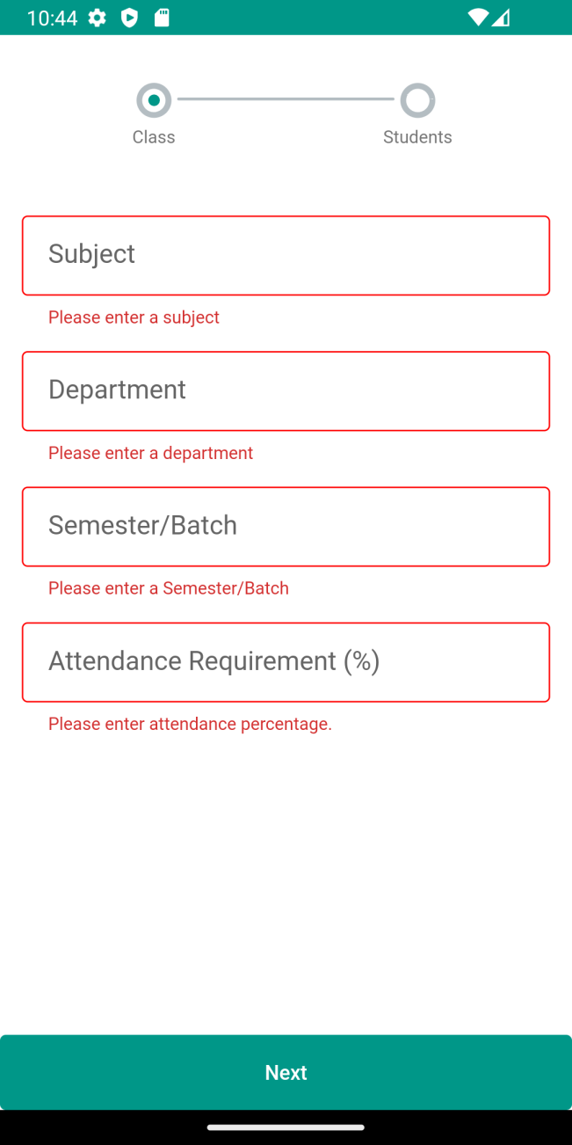
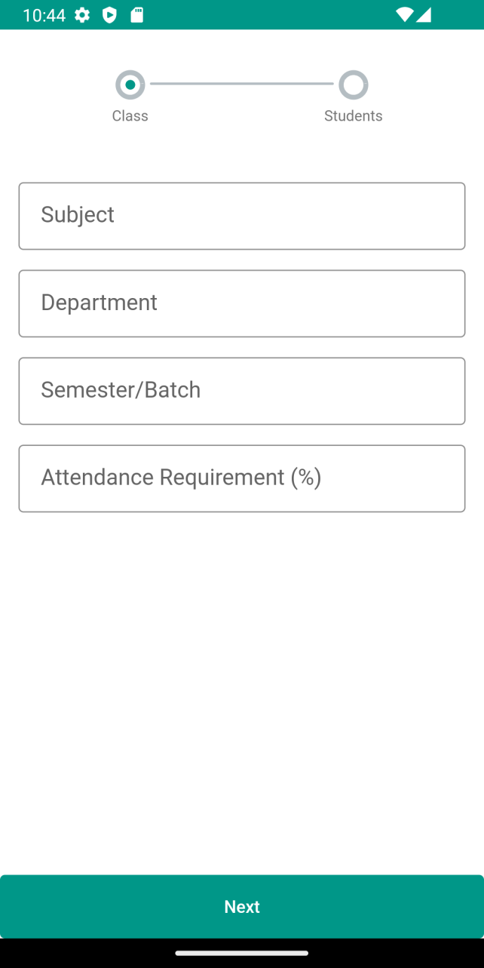
Create a Class

Slide 19
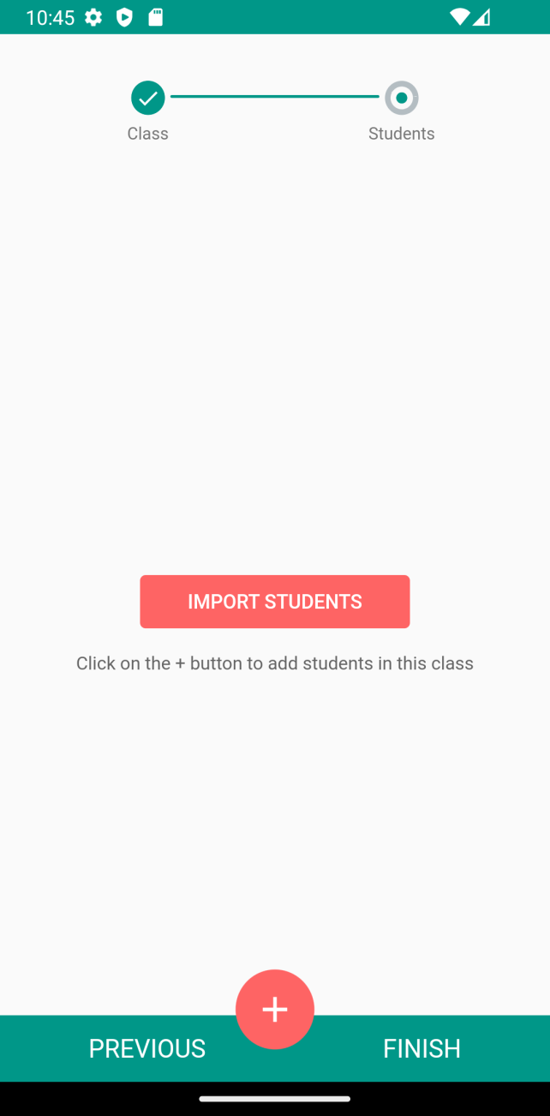
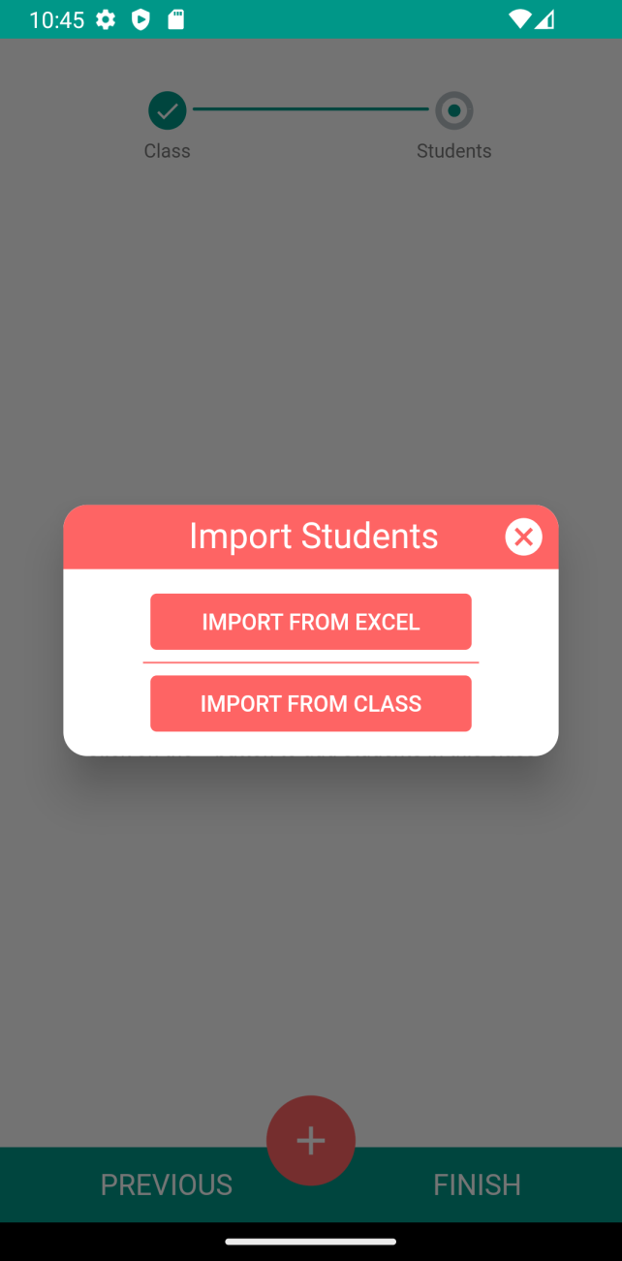
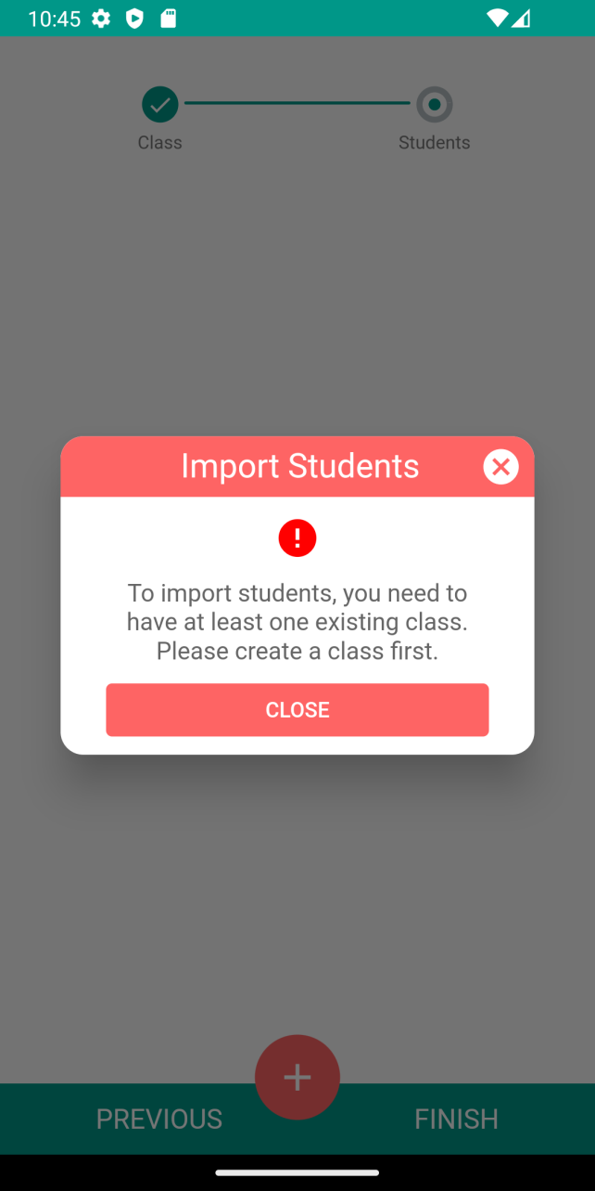
Imports Students In Class

Slide 20
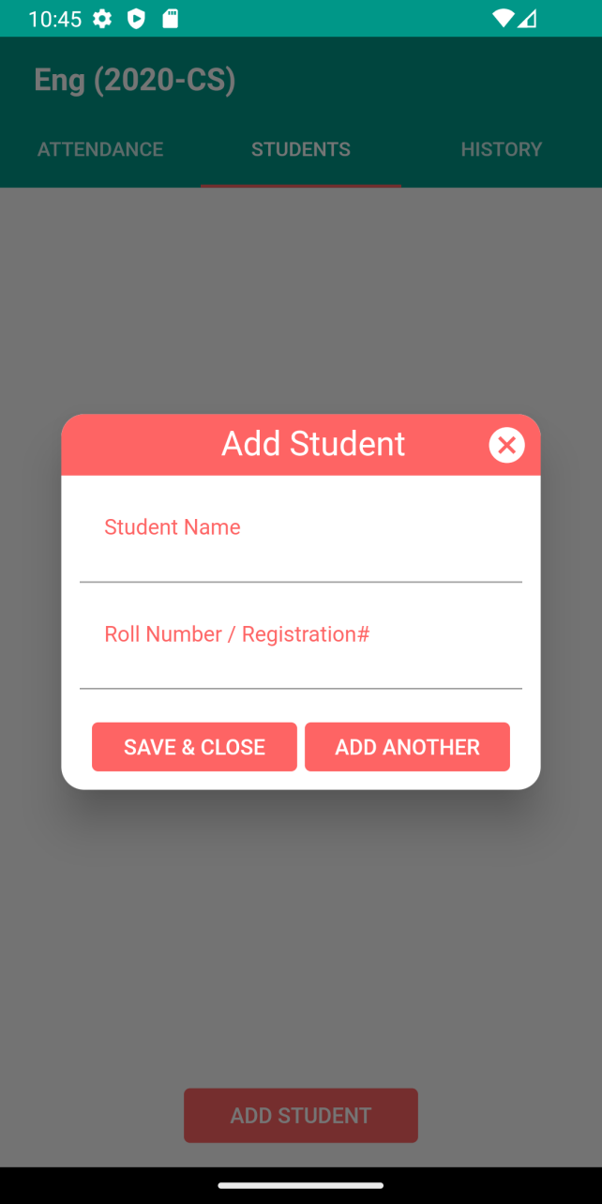
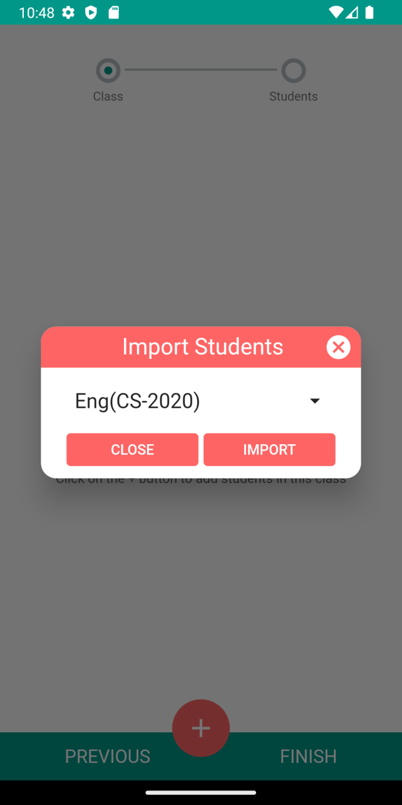
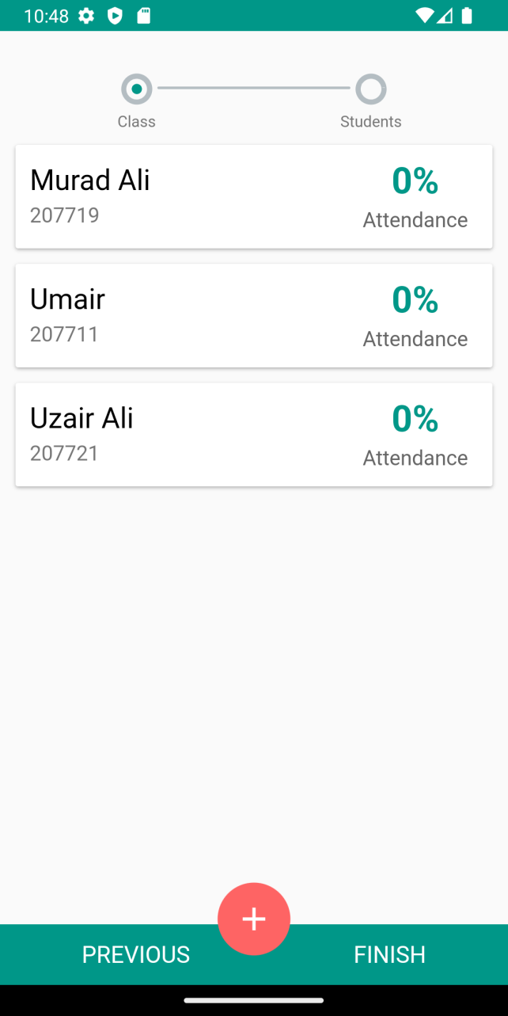
Import Student In Class

Slide 21
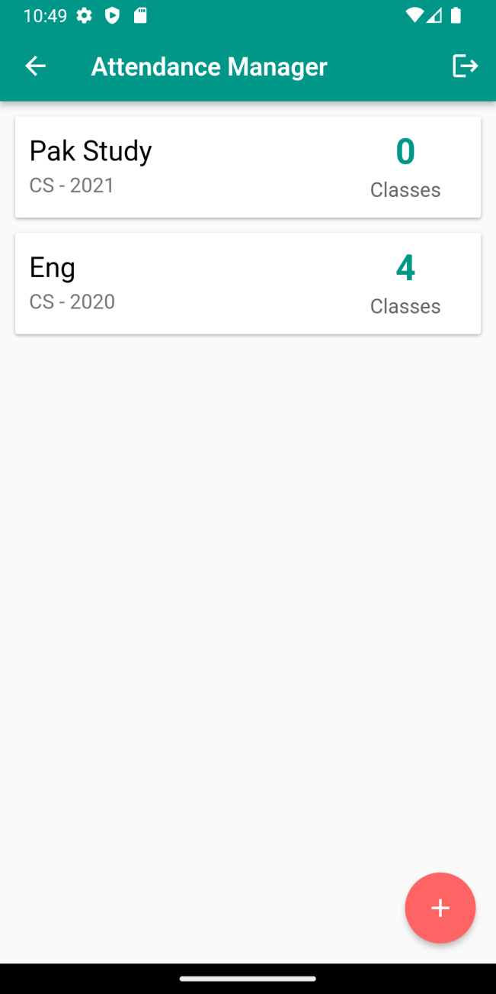
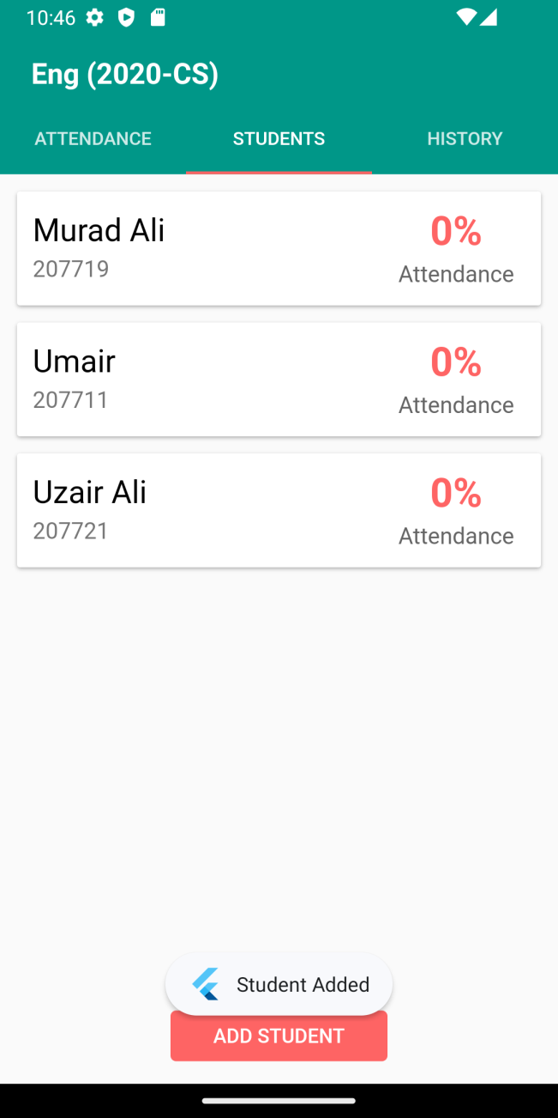
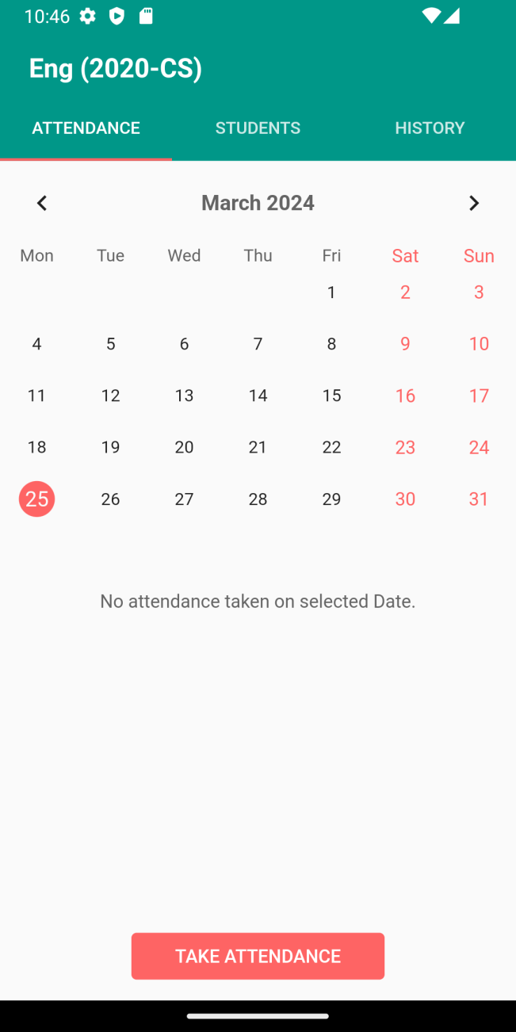
Class Overview

Slide 22
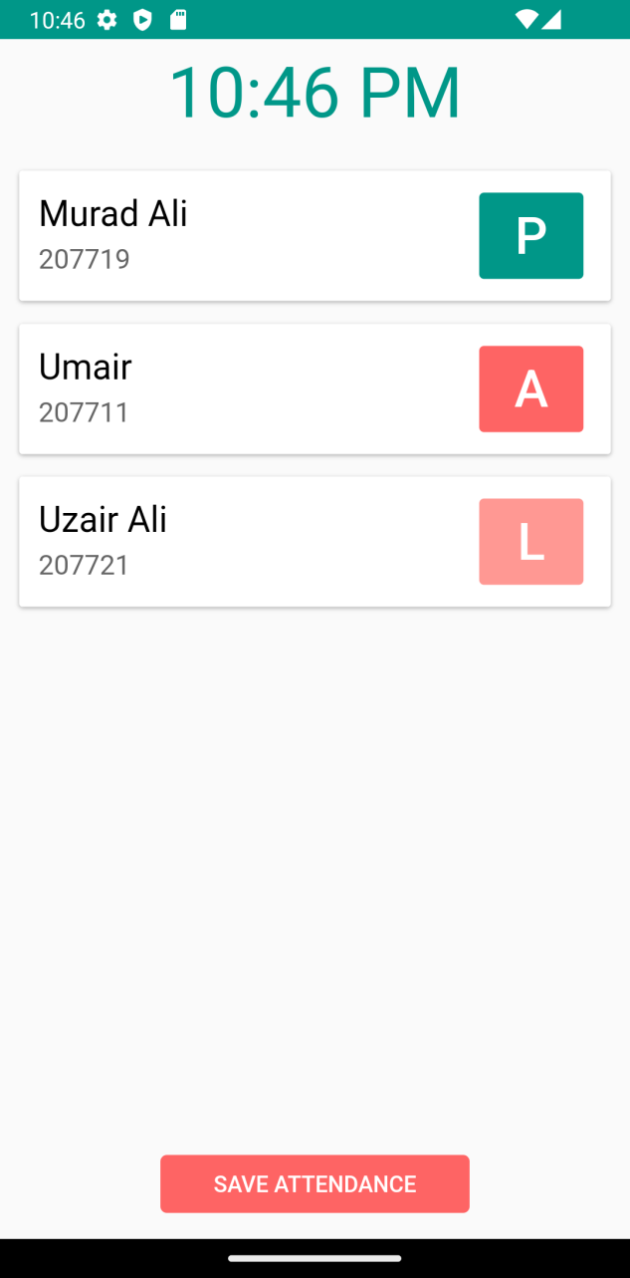
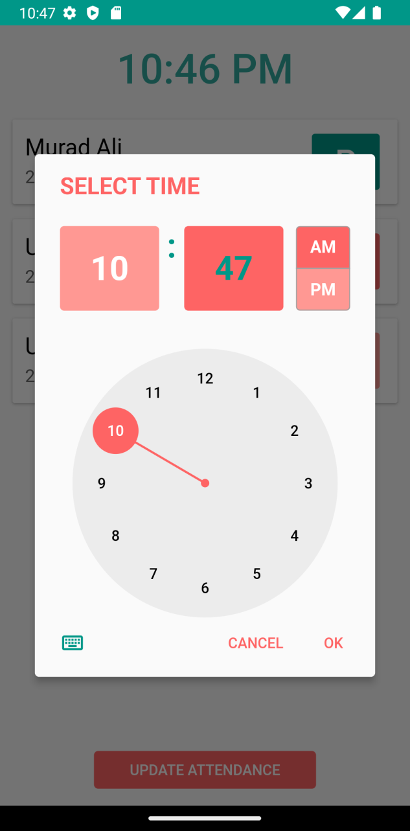
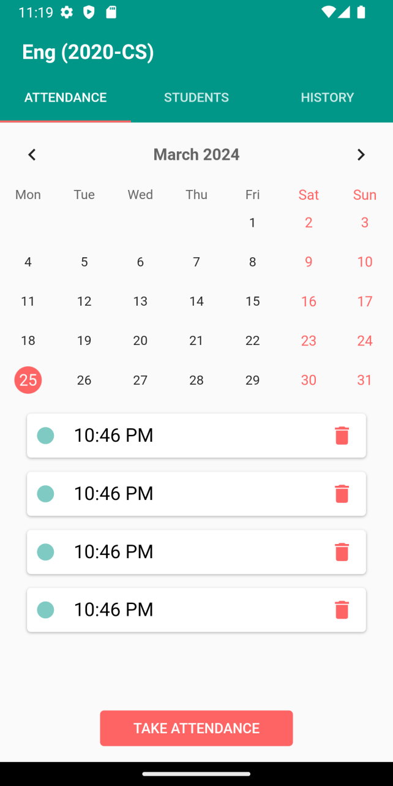
Save Student Attendance

Slide 23
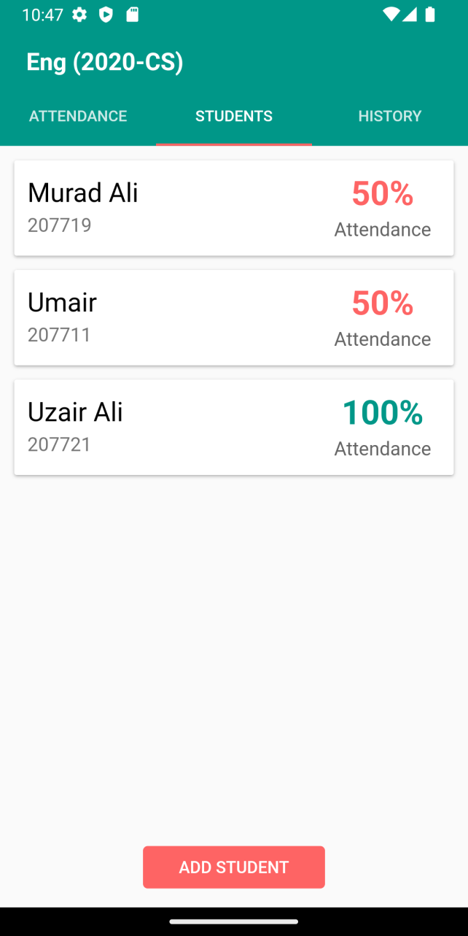
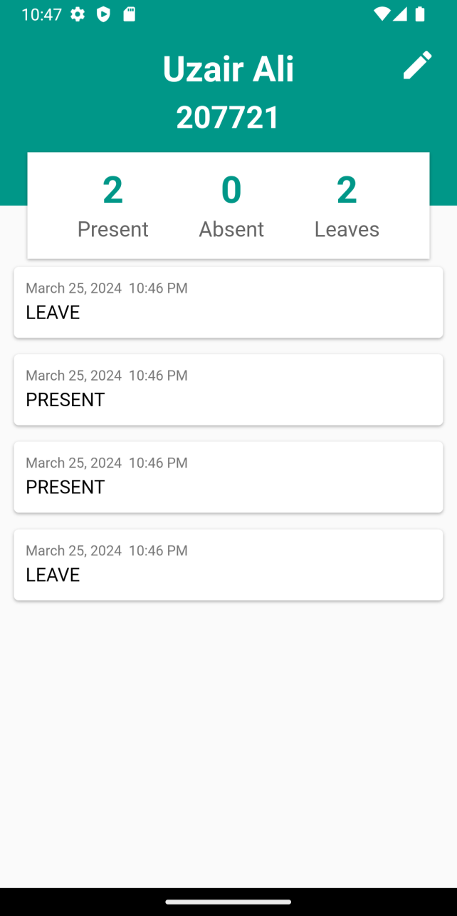
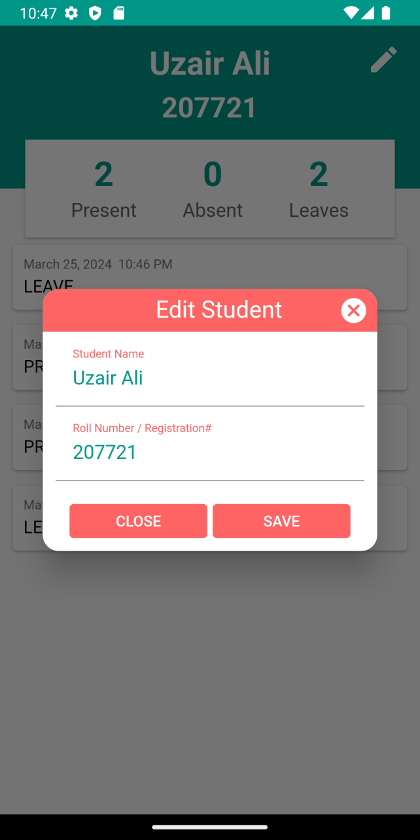
Student Attendance States+ Edit Profile

Slide 24

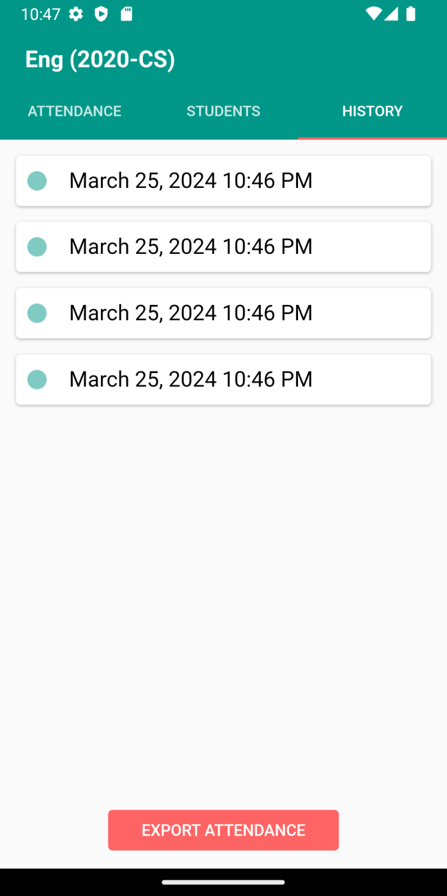
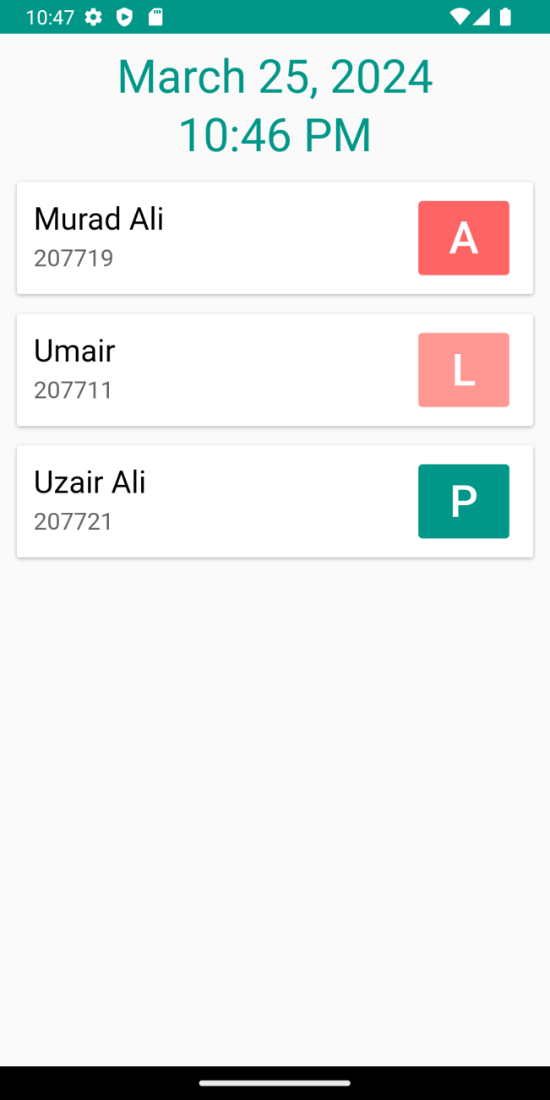
Edit Attendance+ Attendance History

Slide 25
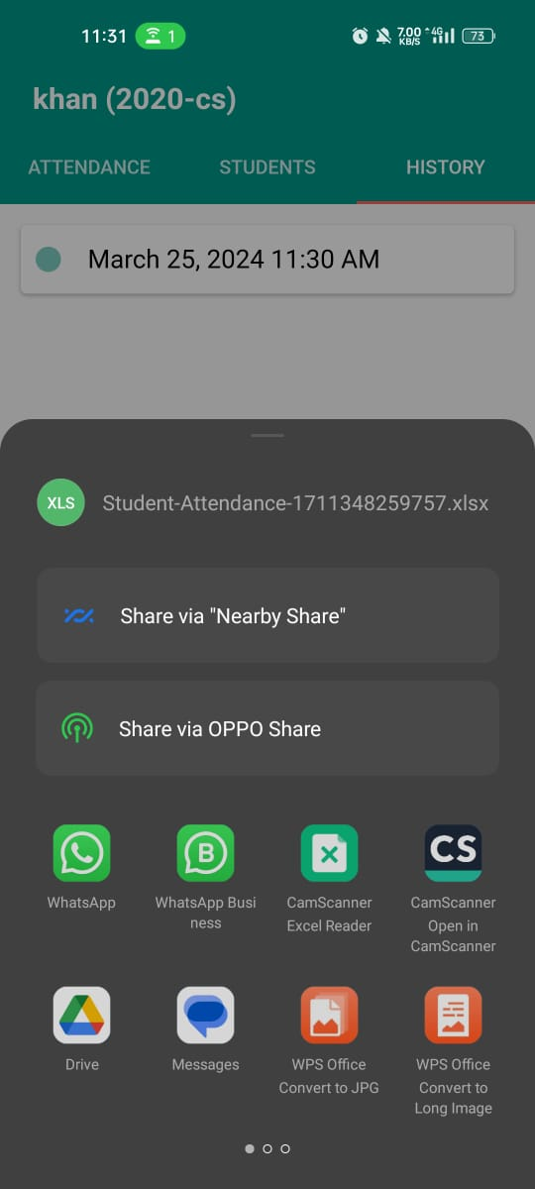
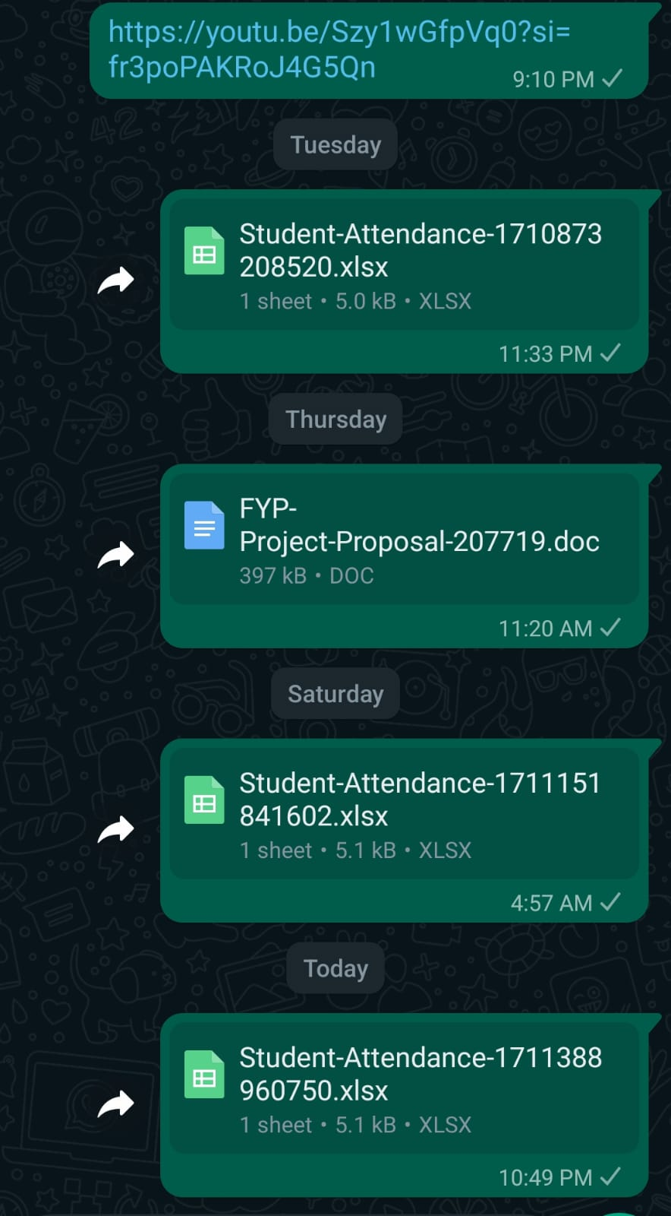
Export Excel File

Slide 26
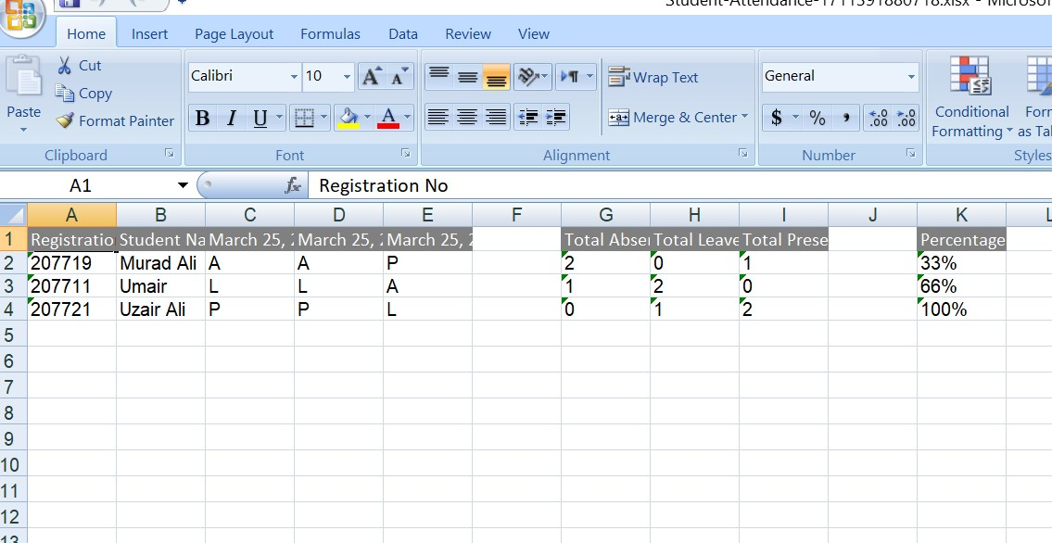
Attendance Records Exported to Excel Sheet

Slide 27
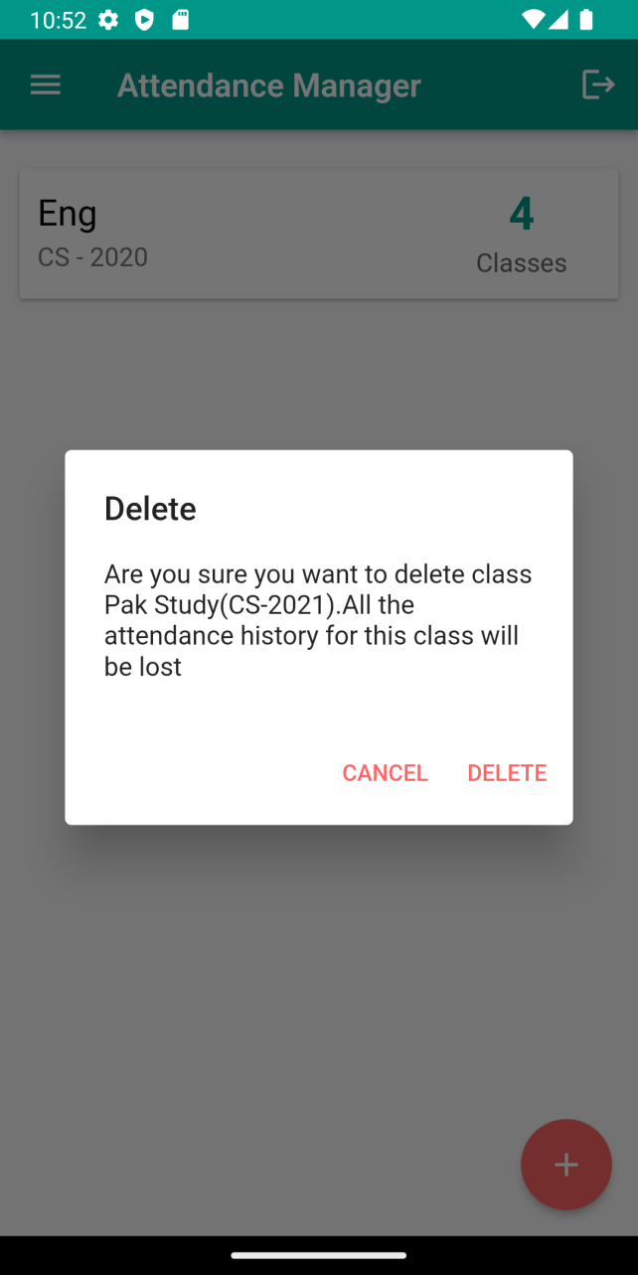
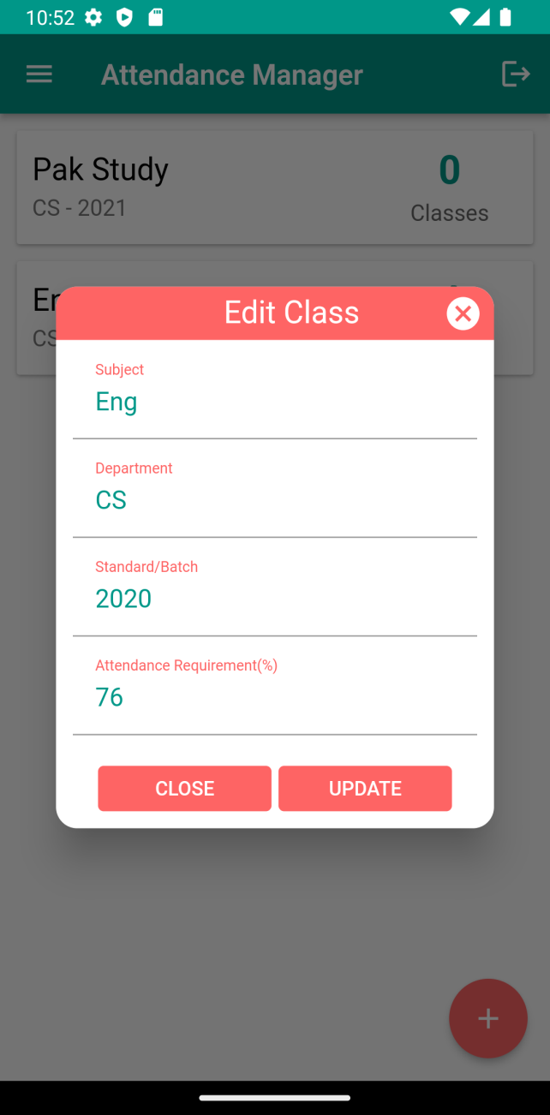
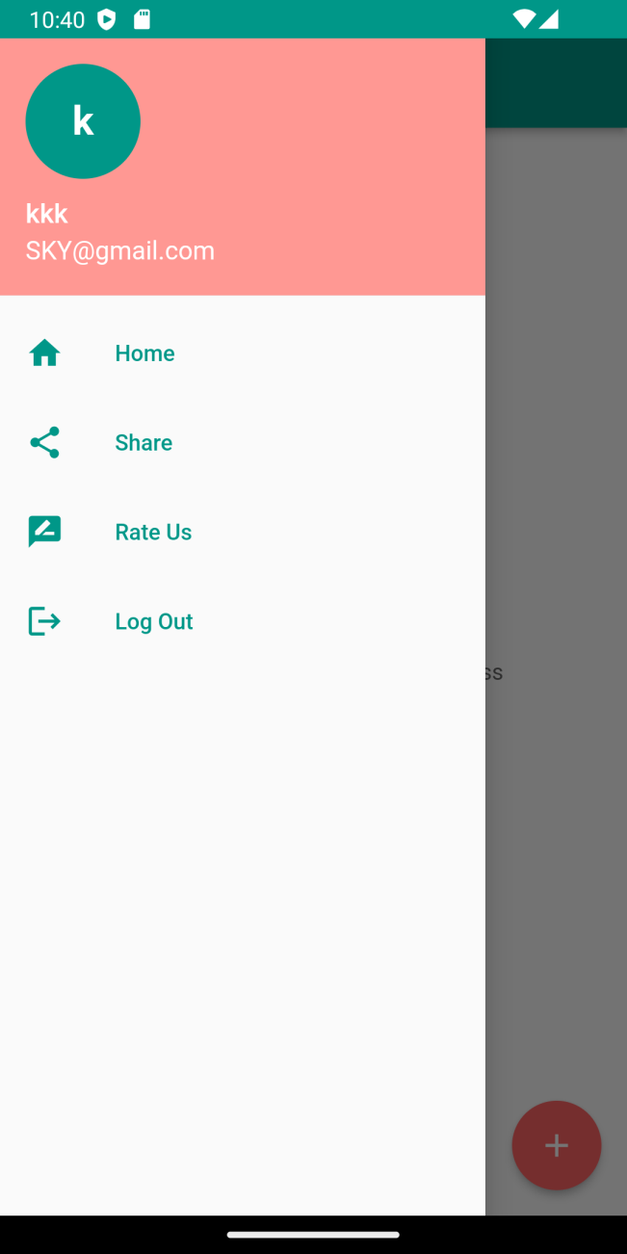
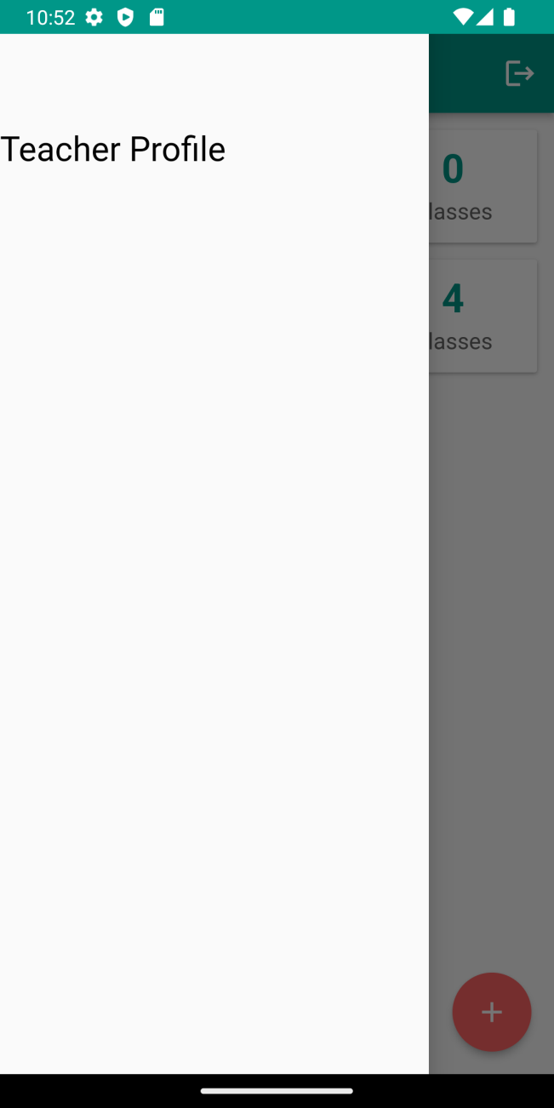
EDIT CLASS + DELETE+Teacher Profile(P)

Slide 28
Admin Module
Admin Module

Slide 29
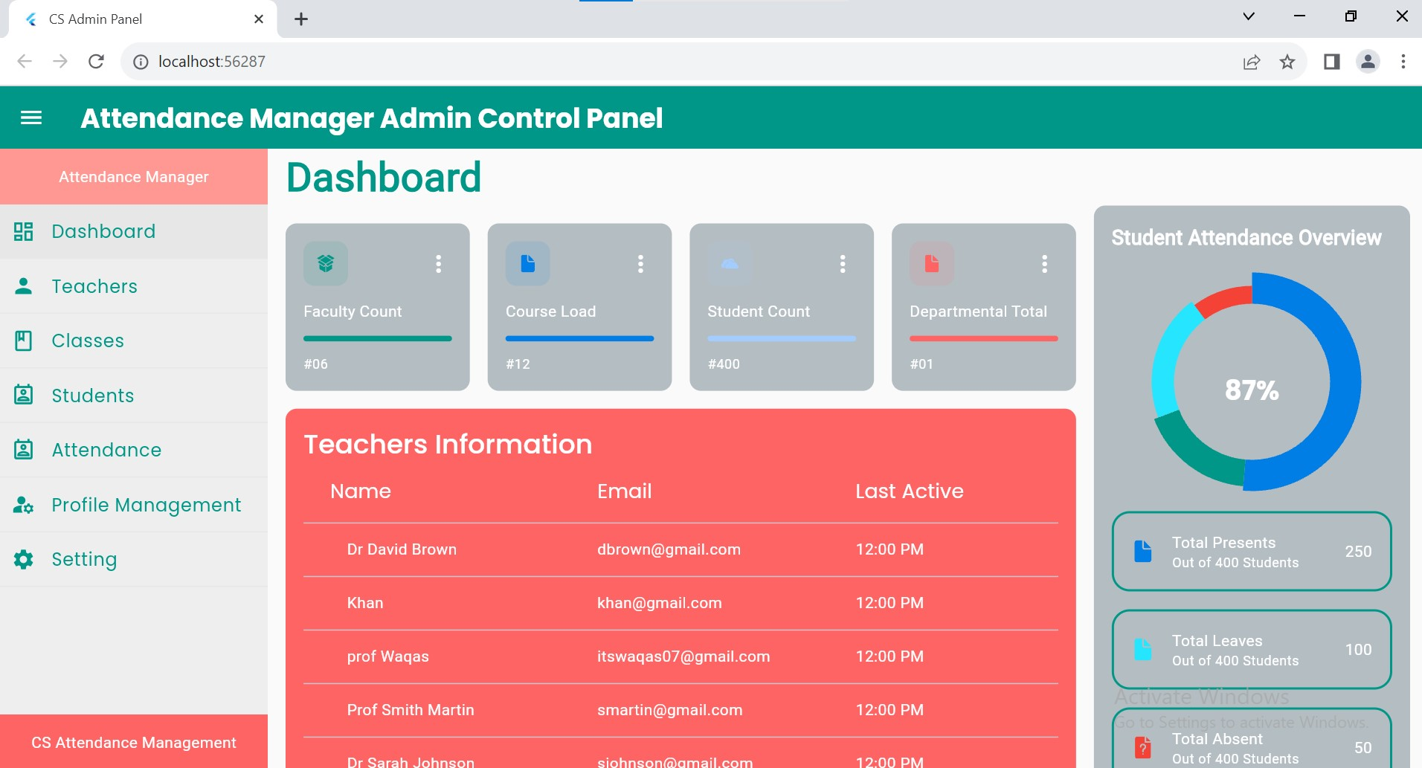

Slide 30
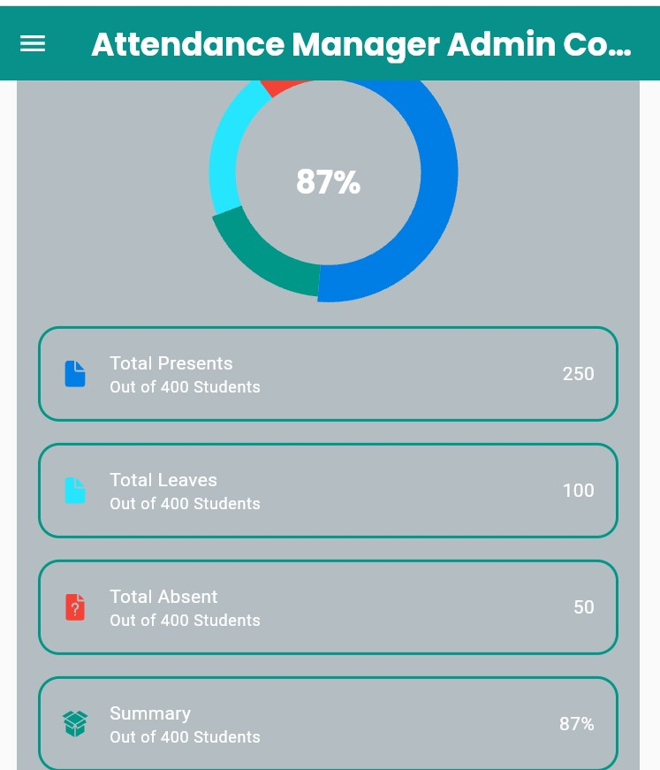
Today Student Attendance States

Slide 31
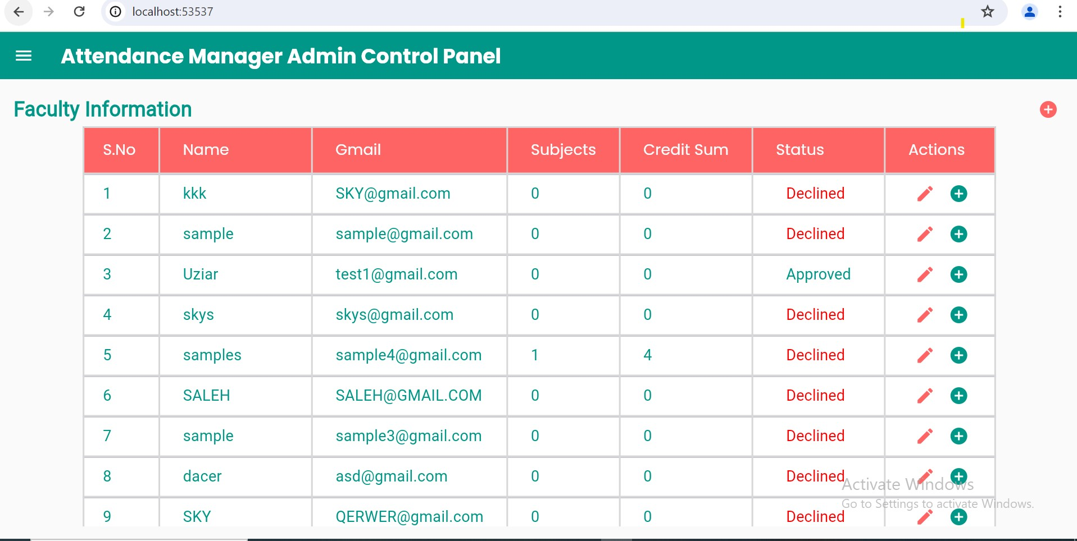

Slide 32
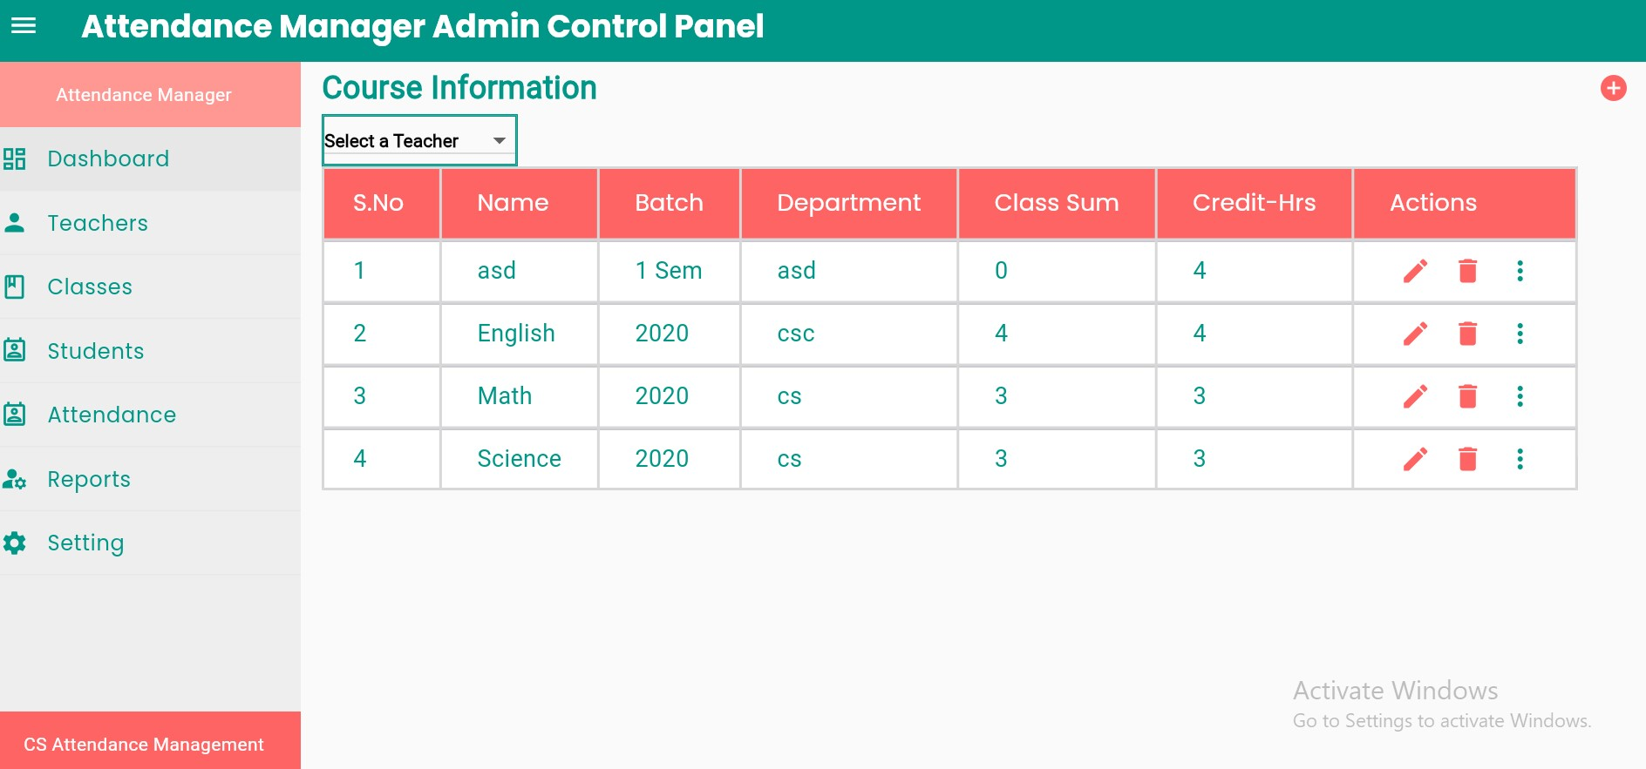

Slide 33
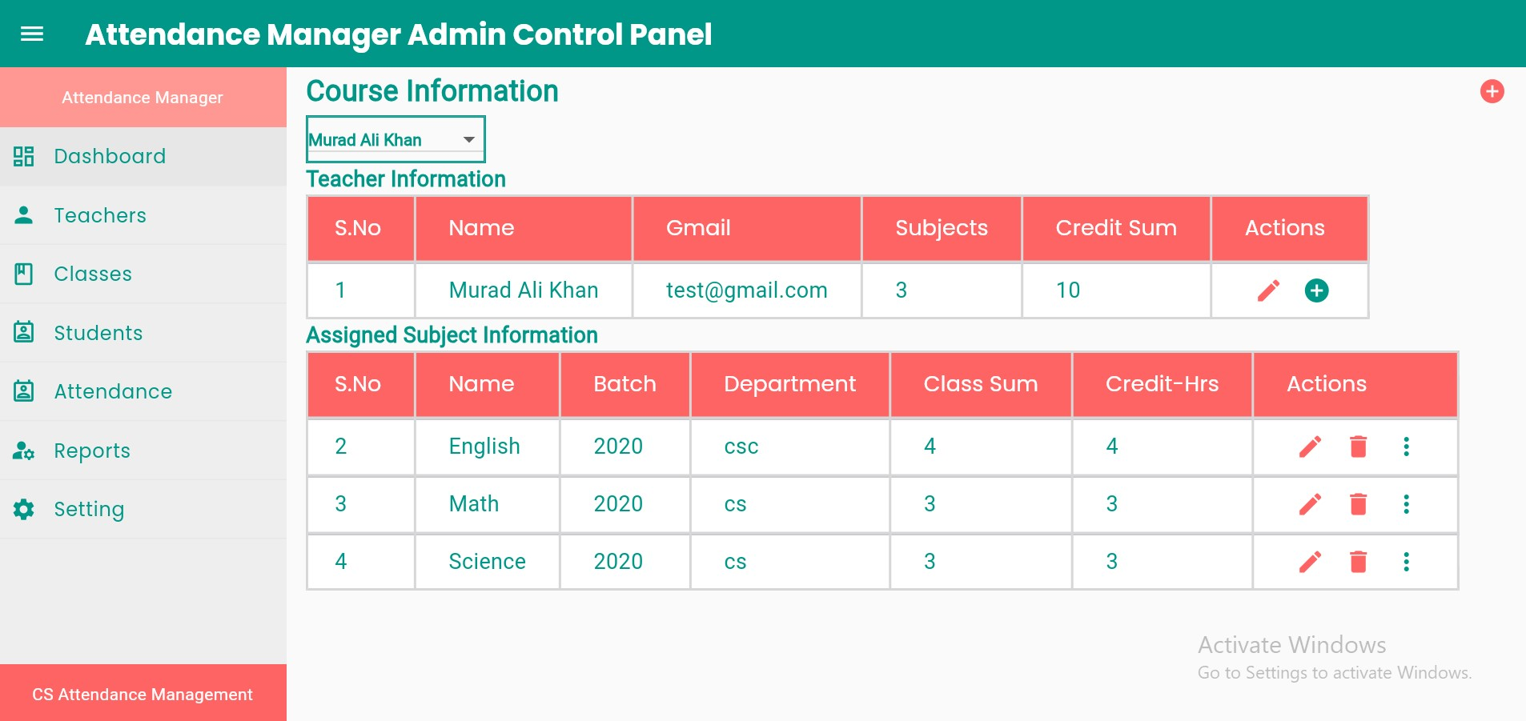

Slide 34
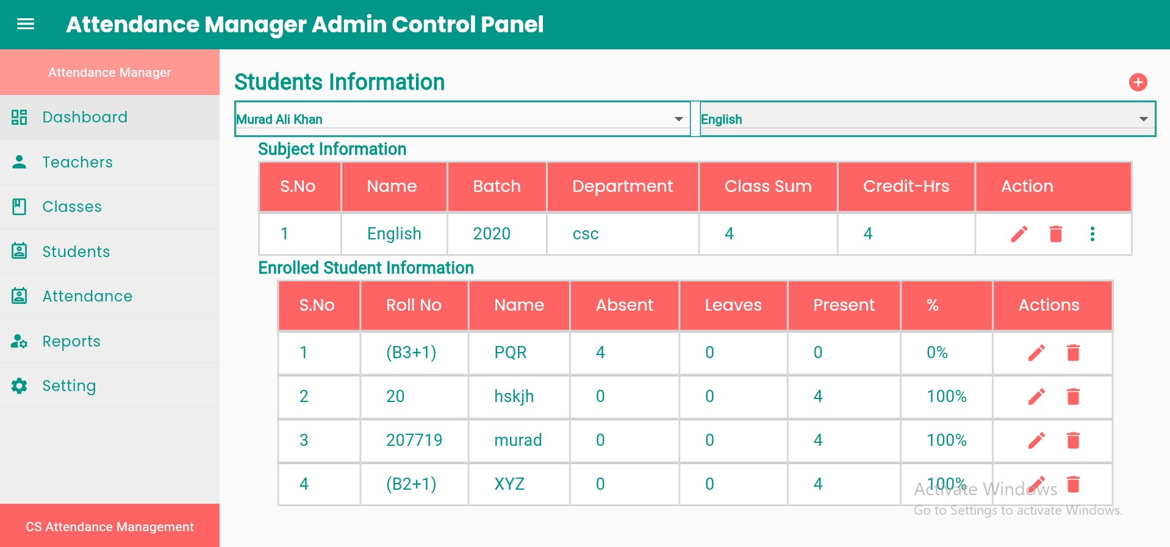

Slide 35
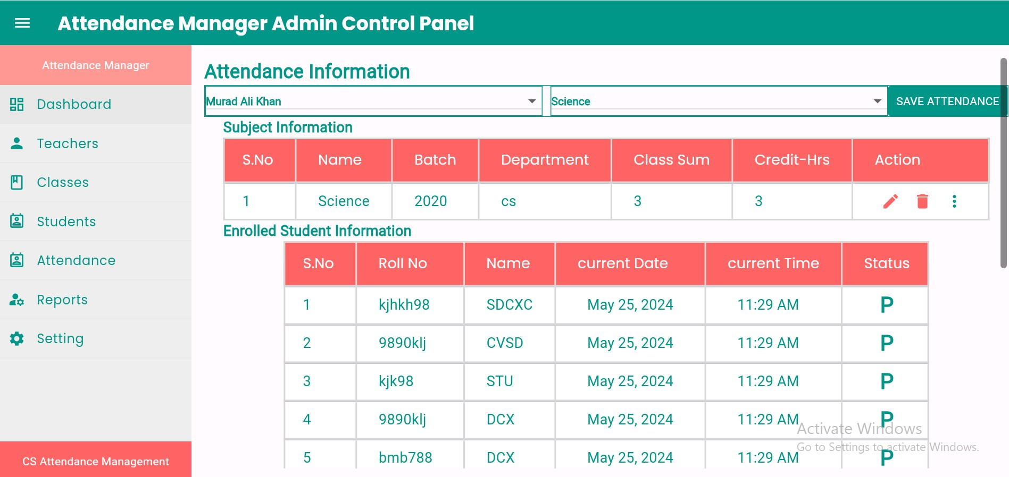

Slide 36
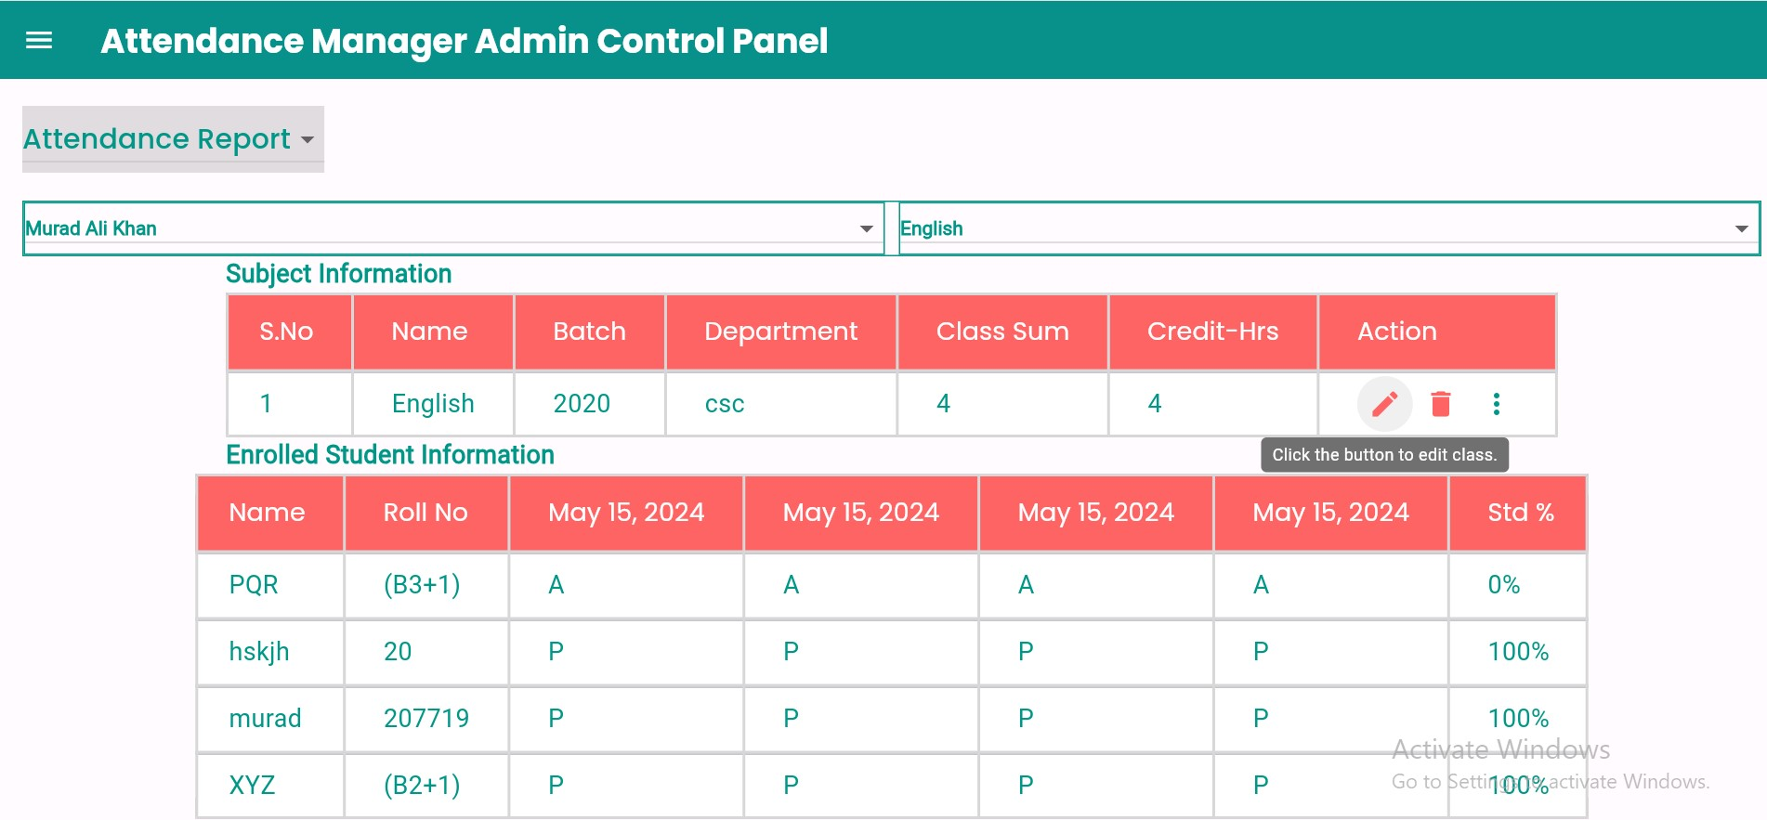

Slide 37
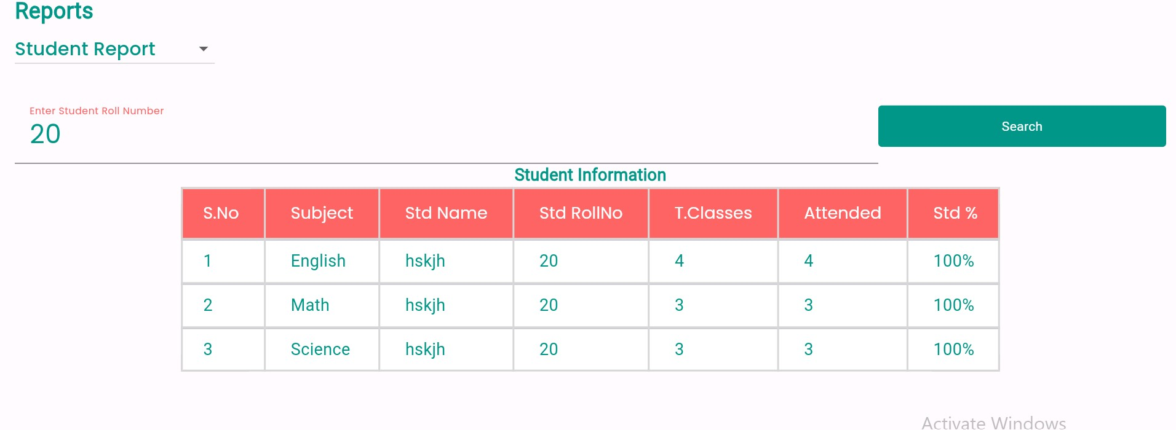

Slide 38
------------END -----------------
THANK YOU!

